Slide 1


Team LOGO/NAME

Slide 2
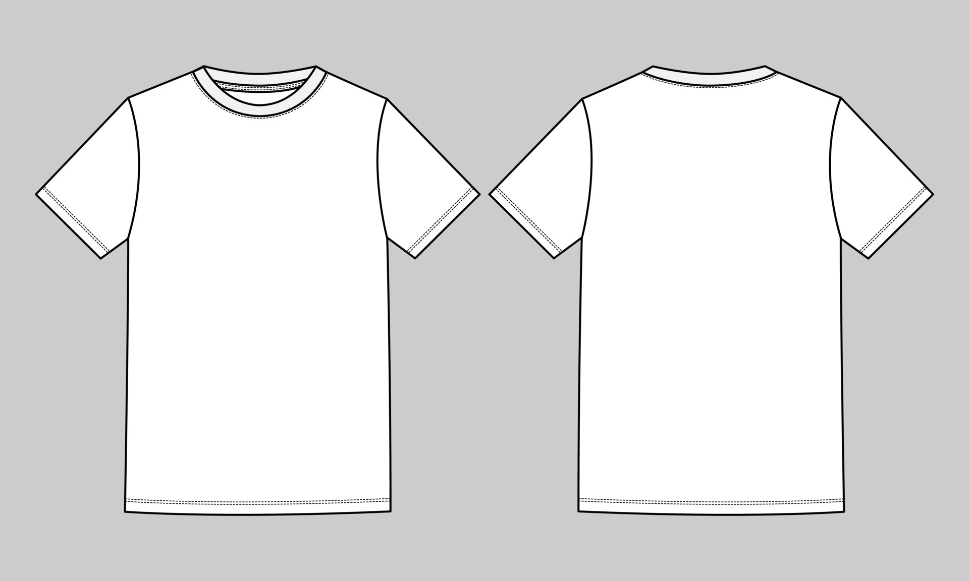
IN- SPACe CANSAT India Students Competition by ASTRONAUTICAL SOCIETY OF INDIA
T-Shirt Template
CANSATLOGO
Sponsor LOGO
Sponsor LOGO
CANSATLOGO
Team Name
IN-SAPCe, ASI and ISRO LOGO
Front
Back

Slide 3

IN- SPACe CANSAT India Students Competition by ASTRONAUTICAL SOCIETY OF INDIA
CAP Template
CANSATLOGO
Team Name
Sponsor LOGO
Team Name
If sponsor is not there, then college/university logo can be used

